Slide 1
Self-Supervised Learning for Visual Tracking and Recognition of Human Hand
By:
Jordan Ketring
Junwoo Jang
Carlos Cuartas
Mostofa Adib Shakib
Airi Shimamura

Slide 2
Overview
- The large variation and richness of visual inputs bring more concern.
- Difficulties: Obtaining a satisfactory generalization & how to automatically select good features for representation.
- Solution for the issues of learning bootstrapping and model transduction: combining both labeled and unlabeled training data.
- Two main examples of self-supervised learning: inductive and transductive learning.
Junwoo

Slide 3
Introduction
-Using Keyboards or joysticks still does not feel realistic in current Virtual Environment.
-Hand tracking and posture recognition & Two approaches: non-parametric and parametric.
-Issues: large variation in skin tone, unknown lighting conditions and dynamic scenes.
-Solution:make a generic statistical skin color model
Junwoo

Slide 4
3D model-based approach & Alternative approach
-Two issues in using this approach: automatic feature selection and training data collection.
-color tracking as transductive learning problem and posture recognition as an inductive learning problem

Slide 5

Unlabeled Data Sorting
Let’s pretend we have a large amount of candy (no label or name).
If you were to sort the candy into appearance you would end up with a few piles.
The candy names are still a mystery to you until you were given a few candies with names attached to them as well.
This is what was done to sort the hand recognition data.
They figured that if they ran a batch of unlabeled data and then ran labeled data after groups were made, that this would assign labels to the groups entirely when they previously unknown.
Carlos

Slide 6
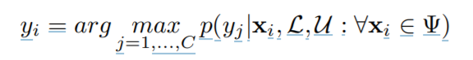
Self-supervised Learning
Using a hybrid training data set found in self-supervised learning we can get one step closer to solve this classification problem.
D=> labeled data set
L=> labeled data (xi is the feature vector and yi is the label)
U=> unlabeled data
Ψ=> subset of the whole data space (IMPORTANT = depending on the Ψ, learning has different cases)
Ω and C=> represent number of classes
Carlos

Slide 7
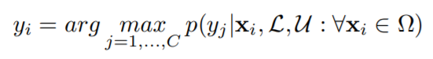
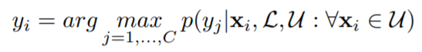
The Inductive and Transductive Problem
We run into one of two problems using the previous equation. When Ψ = Ω it no longer is self supervised learning, its inductive learning.
Inductive learning depends heavily on both supervised data set and unsupervised data set.
What happens is if L or U pass a threshold then it flip flops between completely unsupervised and completely supervised.
A similar problem occurs when Ψ = U. It would no longer be self-supervised but instead Transductive.
Unlabeled data has all possible data points.
Carlos

Slide 8
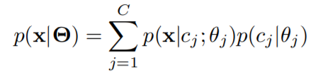
Generative Model
Assuming the data drawn for inputs are from a combined distribution of cj and j, the equation we utilize looks like this:
p(x|Θ) = ! C j=1 p(x|cj ; θj)p(cj |θj ) (5)
X=> Sample drawn from data set
D=> LUU
Θ=> {θj , j = 1,...,C}
Now it's time to move on to the algorithm part of the system.
Carlos

Slide 9
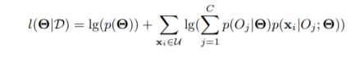
EM Algorithm
Expectation-Maximization Algorithms find the the local maxima of the likelihood of given parameters
Discriminant-EM Algorithm or D-EM
Jordan

Slide 10
Discriminant-EM Algorithm (D-EM)
EM is limited by the requirement to know the probabilistic data structure
Discriminant-EM (D-EM) uses Multiple Discriminant Analysis (MDA) with EM algorithm reduce the requirement of knowing the structure of the data
The labelled set is used to make a weak classifier
The weak classifier is used to weight unlabelled data (Estimation)
MDA is performed on the weighted data (Discrimination)
Maximum likelihoods are estimated (Maximization)
D-EM
Estimation
Discrimination
Maximization
EM
Estimation
Maximization
Jordan

Slide 11
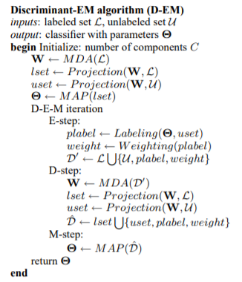
Discriminant-EM Algorithm (D-EM)
Jordan

Slide 12
Experiments
Color Tracking
To evaluate D-EM algorithm in color tracking, use a higher dimensional color space (6D) by combining HSV and RGB spaces
Assume the segmentation is known to calculate classification errors
Use two “hand images”, I1 (segmented image) and I2 (the same image as I1 except the color distribution) as inputs
Compare the classification error rates that are given by D-EM and EM algorithms
Apply D-EM algorithm to a different number of labeled and unlabeled samples (using 20% unlabeled data, 50% unlabeled data ...etc)
Airi

Slide 13
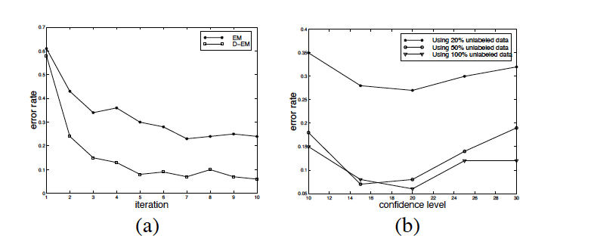
Result
(a) shows the comparison between EM and D-EM.
(b) shows the effect of number of labeled and unlabeled data in D-EM
Airi

Slide 14
Experiments
Hand Posture Recognition
Construct a testing data set, which consists of 560 labeled images
Physical (P-) and , mathematical (M-) features are both used as hand representation
Use the mathematical features extracted by PCA and the dimension for MDA
Apply D-EM algorithm to a different number of labeled and unlabeled samples (using 500, 1000, 2500 …etc unlabeled samples, and 42, 56, 84...etc labeled data)
Compare different classification algorithms
Airi

Slide 15
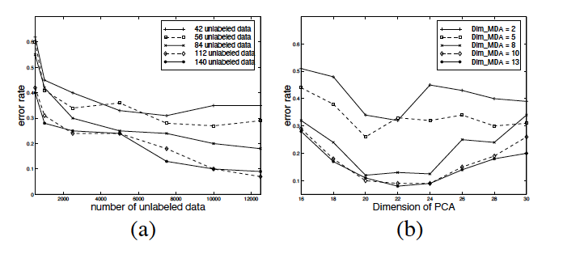
Result
(a) shows the effect of labeled and unlabeled data in D-EM.
(b) shows the effect of the dimension of PCA and MDA in D-EM
Airi

Slide 16
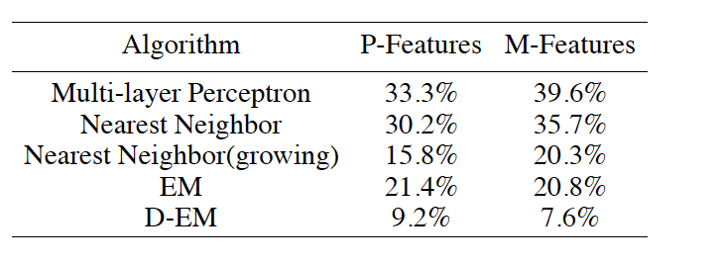
Result
Table 1: Comparison among different algorithms
Airi

Slide 17
Advantages of the proposed D-EM framework
EM often fails when structure assumption does not hold, whereas D-EM offers a way to relax the assumption of probabilistic structure.
Since data to some extent are clustered in the projected space, therefore, it is easy to select the structure of gaussian mixture models.
Adib

Slide 18
Recap
Self-supervised learning utilizes both supervised and unsupervised training data sets
Inductive learning and transductive learning can be treated as two special cases of self-supervised learning
Two approaches in self-supervised learning:
Expectation-Maximization (EM) framework
Proposed Discriminant-EM (D-EM) framework
Self-supervised learning automatically selects a good classification feature
Experiments show that the proposed D-EM algorithm outperforms some other learning techniques, and self-supervised has many potential applications.
Adib

Slide 19
Thank You

